Slide 1
Comprehensive Digital Marketing Project Work On Noise
Team Details
K J JOSEPH JERIN (TEAM LEADER)
B JOSITH NAVEEN (TEAM MEMBER)
SANA TEJASWI (TEAM MEMBER)
SOMAYAJULA SURNARAYANA (TEAM MEMBER)
KAMMA SAI SREE ANEESHA (TEAM MEMBER)
KOTTANA MADHU (TEAM MEMBER)

Slide 2
Comprehensive Digital Marketing Project Work On Noise
Team Members
Acknowledgement
I am K J JOSEPH JERIN, as a Team Leader I have done these following Work in this Project
1. Power Point Presentation
2. Brand study,
3. Competitor Analysis

Slide 3
Comprehensive Digital Marketing Project Work On Noise
Team Members
Acknowledgement
I am SANA TEJASWI , as a Team Member I have done these following Work in this Project
PowerPoint Presentation
Buyers Audience Persona
SEO Audit

Slide 4
Comprehensive Digital Marketing Project Work On Noise
Team Members
Acknowledgement
I am B JOSITH NAVEEN , as a Team Member I have done these following Work in this Project
1. Powerpoint Presentation
2. Keywords Research
3. On Page Optimization

Slide 5
Comprehensive Digital Marketing Project Work On Noise
Team Members
Acknowledgement
I am KOTTANA MADHU , as a Team Member I have done these following Work in this Project
1. Powerpoint Presentation
2. Content Idea Generation & Strategies
3. Marketing Strategies

Slide 6
Comprehensive Digital Marketing Project Work On Noise
Team Members
Acknowledgement
I am SOMAYAJULA SURNARAYANA , as a Team Member I have done these following Work in this Project.
1. Power Point Presentation
2. Post Creation
3. Designs/ Video Editing

Slide 7
Comprehensive Digital Marketing Project Work On Noise
Team Members
Acknowledgement
I am KAMMA SAI SREE ANEESHA , as a Team Member I have done these following Work in this Project
1. Powerpoint Presentation
2. Social Media Ad Campaigns
3. Email Ad Campaigns

Slide 8

About Our Project
Company / Topic for project:
NOISE
Research Brand Identity:
Brand logo:
Brand colours : Black and White
Brand tagline : “As we seek we find, as we explore we discover”.
Brand’s website : https://www.gonoise.com/

Slide 9

BRAND STUDY OF NOISE
About the Logo Of NOISE:-
The Noise logo is a celebration of the Brand's progress and innovative approach.
It is a great symbol of a powerful company with a bright future and values of its heritage.
The Icon and the Name tells about Smart Wearables & Hearables
The Modern Abstract Representation of the letter N.

Slide 10

BRAND STUDY OF NOISE
About the Logo Of NOISE:-
The Icon Communicates a sense of Engineering and Intelligence. The Black Colour in the Logo Shows the Continuity, Change and also Confidence.
The White Colour in the Logo’s Symbol Shows the
Smart Wearables & Hearables
The Black Colour Indicates of Products which can Produce Good Quality Sounds
The Logo is Geometrical and Attractive.

Slide 11
BRAND STUDY OF NOISE
About the Mission Of NOISE :
The Company aspires to deliver the best and the most cost-effective products & solutions empowered by superior technologies.
The Company, is committed to give their best and Achieve the Highest Standards in Performance, Quality, Systems, Care and Relationships. And then we want to beat these High Standards and go further because anything that can be done can be done better.”
The Company is committed in ensuring value for money by developing high-quality, environment-friendly and efficient solutions that fulfil the diverse needs of customers.

Slide 12
BRAND STUDY OF NOISE
About the Vision Of NOISE:
The Company aspires to deliver the best and the most cost-effective products & solutions empowered by superior technologies.
Noise is Renewing its focus on Smart Wearables & Hearables. (Wireless Headphones with Advanced Features)
We aim to be the biggest player in the Indian Market, a Household name with young, high tech Indian consumers and a brand Indians are be proud of.

Slide 13
COMPETITOR ANALYSIS OF NOISE
About the Other Competitors With Noise :-
NOISE Has Many Competitors Across India they are as follows :
Boat Lifestyle
Xiaomi
Nothing
Realme
Fire Boltt
Portronics

Slide 14
Buyers Persona
Buyers Persona :
A buyer persona—also called a user persona, marketing persona, or audience persona—is a fictional profile of your ideal customer based on market and audience research.
In other words, it’s an imaginary person that embodies the most important characteristics found within your broad audience.
Just like a real living and breathing customer, a buyer persona should have a demographic and psychographic profile, behavior trends, values, desires, pain points, and affiliations.

Slide 15
Buyers Persona
Buyers Persona :
Though the persona is fictional, the profile should be as well rounded as possible.
Generating buyer personas isn’t about describing a potential customer or a vision for business expansion.
To the contrary, the buyer persona should reflect individuals who already exist within your target market to help marketing, sales, and product departments make better decisions..

Slide 16
Buyers Persona
Buyers Persona :
Working with buyer personas can help: Guide product development Inform content generation efforts.
Provide insights for lead follow-up
Improve customer acquisition and retention strategies.
After an initial market assessment, creating buyer personas is the next logical step for businesses. This step allows businesses to understand their target market thoroughly before making significant investments in product development, marketing strategies, and sales infrastructure.

Slide 17
Buyers Persona
Buyers Persona :
In practice, buyer personas can help drive many essential processes within a company. Here are a few examples:
Product development—Buyer personas offer valuable insights into the needs, preferences, and pain points of the target audience. This understanding helps businesses develop products that meet customer needs and provide solutions to their problems.
Marketing strategy—Buyer personas help businesses understand audience motivations and behaviors, which can help craft messaging that drives engagement.

Slide 18
Buyers Persona
Buyers Persona :
Sales Infrastructure—Buyer personas can help you identify the most effective sales channels and tactics for your target audience so businesses can tailor their sales approach.
Customer Support—Buyer personas can help you provide better customer support by understanding your audience’s communication preferences and support needs.

Slide 19
SEO Audit
Report on the Audit of the Standalone :
An SEO audit is the process of evaluating how well your website is optimized for search engines.
It identifies errors that can prevent your site from ranking well and opportunities that can help you gain more visibility.
An SEO audit usually covers areas like: Indexing and crawlability User experience Site architecture Competitor bench marking
Keyword research On-page SEO Backlink profile It is basically an overall “health check” for a website.

Slide 20
SEO Audit
Report on the Audit of the Standalone :
Check for Indexing Issues Pages that are not indexed are not in Google’s database.
Google can’t rank them. To see whether your pages have been indexed, check for issues directly in Google Search Console.
Head to the “Pages” report under the “Index” section in the left menu. Here, you can see a graph of all pages based on their indexing status.

Slide 21
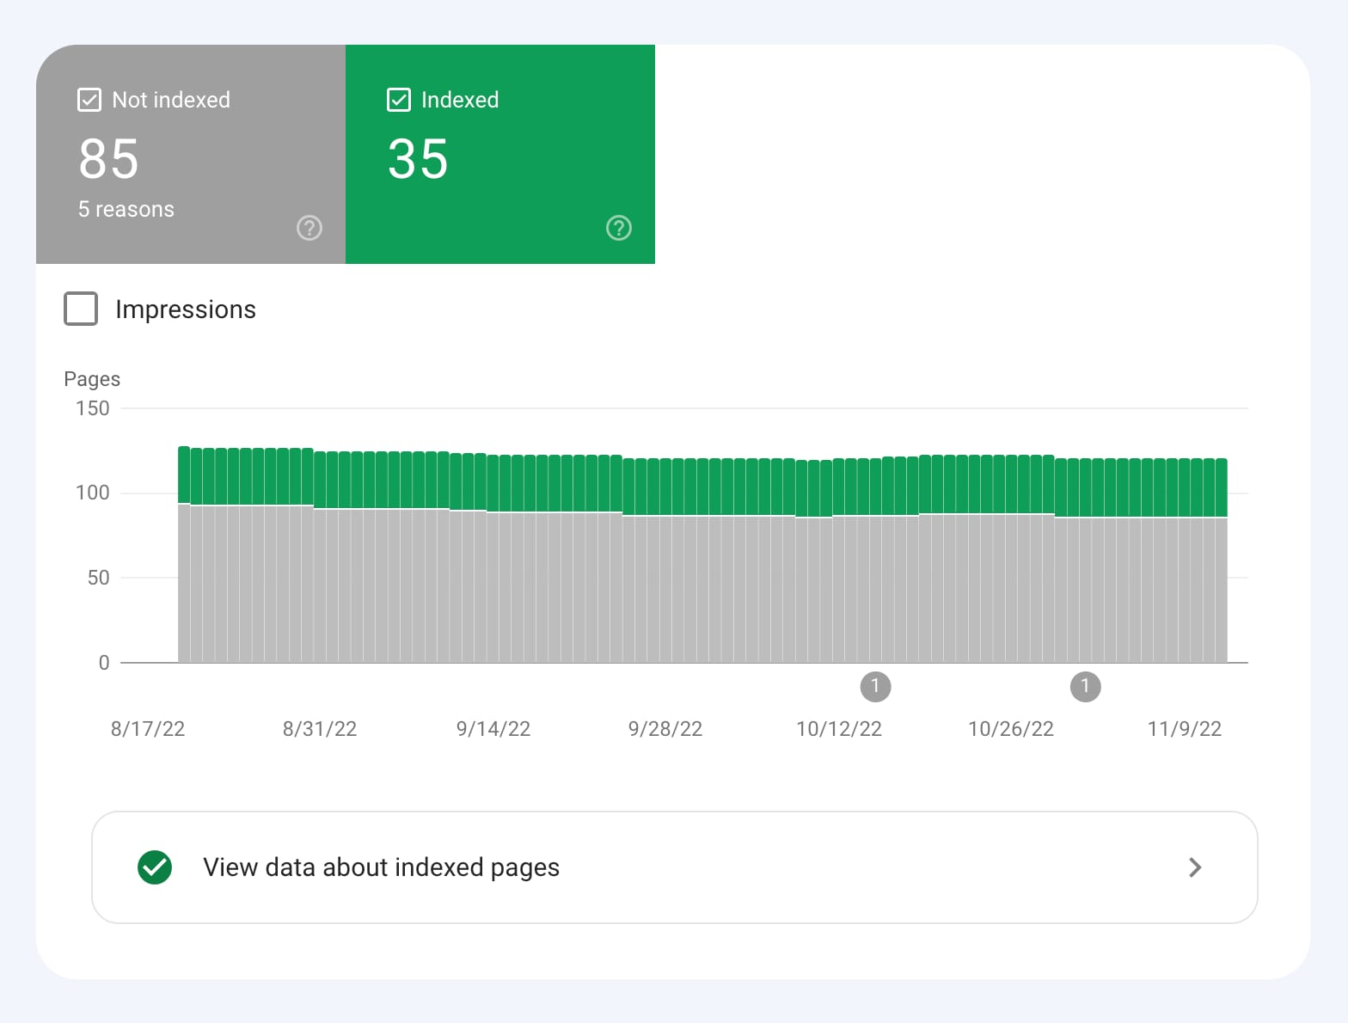
SEO Audit
Report on the Audit of the Standalone :
Check for Indexing Issues Pages that are not indexed are not in Google’s database.
Google can’t rank them. To see whether your pages have been indexed, check for issues directly in Google Search Console.
Head to the “Pages” report under the “Index” section in the left menu. Here, you can see a graph of all pages based on their indexing status.

Slide 22
SEO Audit
Report on the Audit of the Standalone :
Check for Duplicate Versions of Your Site It is essential to ensure that Google is indexing only one version of your site. Your site could sit on various versions of a URL (depending on whether there’s WWW in the domain and whether your site uses HTTPS).
To a search engine, these are all different versions of the site: http://www.yoursite.com
http://yoursite.comhttps://
www.yoursite.comhttps:/
If your website runs on more than one of these URL versions, it can cause many issues with crawling, indexing, and ranking. Especially because Google will take them as duplicates.

Slide 23
SEO Audit
Report on the Audit of the Standalone :
Run a Site Crawl
A good SEO audit is crawl-based.
That means you should be able to simulate the way Google crawls your pages.
And see all issues related to those pages the way Google might see them.
To do that, you’ll need a website SEO auditing tool like Site Audit.
First, you’ll create a project and set up the audit.

Slide 24
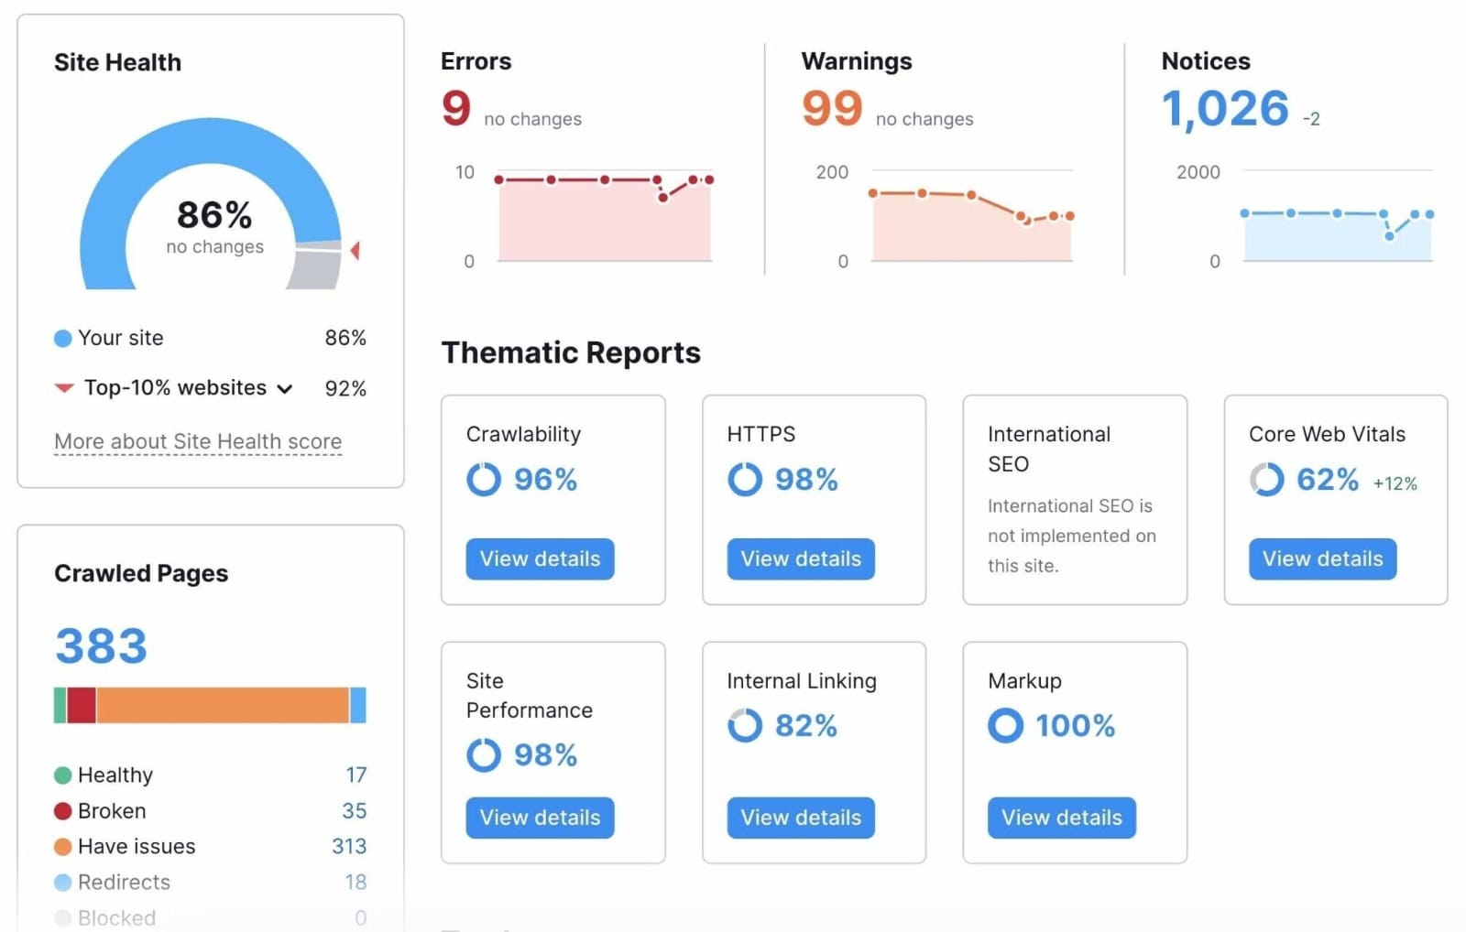
SEO Audit
Report on the Audit of the Standalone :
Run a Site Crawl
A good SEO audit is crawl-based.
That means you should be able to simulate the way Google crawls your pages.
And see all issues related to those pages the way Google might see them.
To do that, you’ll need a website SEO auditing tool like Site Audit.
First, you’ll create a project and set up the audit.

Slide 25
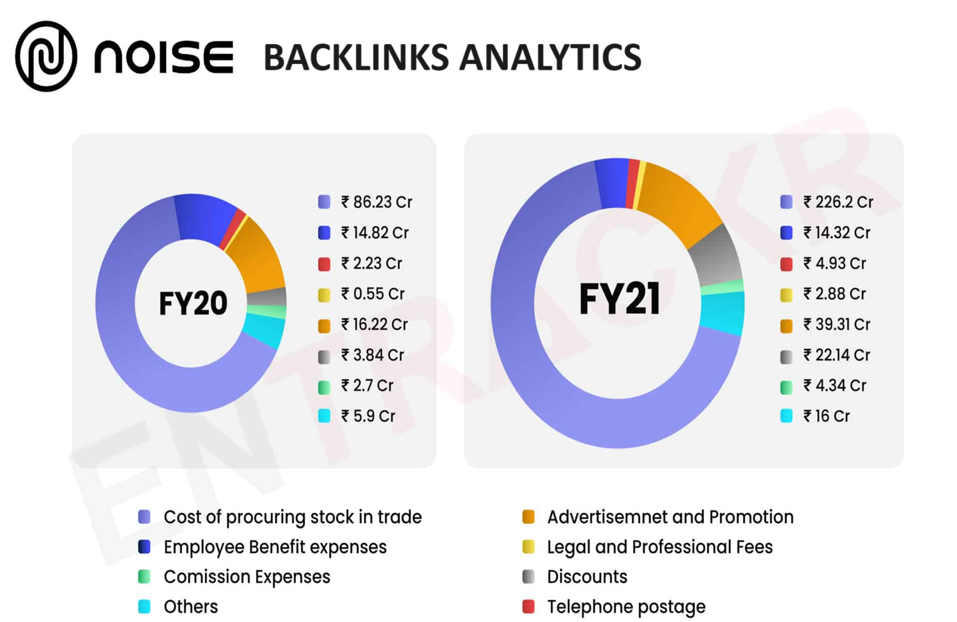
SEO

Slide 26
Keywords Research
OBJECTIVES FOR KEYWORD RESEARCH :
TO INCREASE WEBSITE TRAFFIC :
As keyword research helps us know which key words are used by
target customer mostly, by this we can improve our website traffic.
TO IMPROVE ORGANIC SEARCH RANKING :
By keyword research we can know which key words are performing best, which high search volume and lower competition, so that we can optimize our website with those key words to improve organic search ranking.
TO REACH OUT MORE AUDIENCE :
Keyword research helps us find out which keys are god to target out
prospective customers and so that we can use those keywords in our website's content.

Slide 27
Keywords Research
KEY INSIGHTS :
1. Targeted content creation: Keyword research helps identify the topics and questions that your target audience is searching for. By incorporating these keywords into your content strategy, you can create valuable, relevant content that meets the needs of your audience.
2. Enhanced user experience: Understanding user search intent through keyword research allows you to align your content with what users are looking for. This improves the overall user experience on your website, leading to increased engagement, longer visit durations, and lower bounce rates.
3. Competitive Advantage: By focusing on these untapped keywords, you can gain a competitive advantage and attract targeted traffic that your competitors are missing out on.

Slide 28
Keywords Research
CHALLENGES FACED DURING KEYWORD RESEARCH AND ANALYSIS :
Limited data accuracy :
Keyword research tools provide estimates and data based on historical trends. It's essential to consider this potential limitation when conducting keyword analysis.
Highly competitive keywords :
Some keywords may have high search volume but also intense competition. Ranking for such keywords can be challenging, especially if your website or content is relatively new.

Slide 29
Keywords Research
PROCESS OF CONDUCTING KEYWORD RESEARCH:
Limited Data Accuracy:
Keyword research tools provide estimates and data based on historical trends. It's essential to consider this potential limitation when conducting keyword analysis.
Highly Competitive Keywords:
Some keywords may have high search volume but also intense competition. Ranking for such keywords can be challenging, especially if your website or content is relatively new.

Slide 30
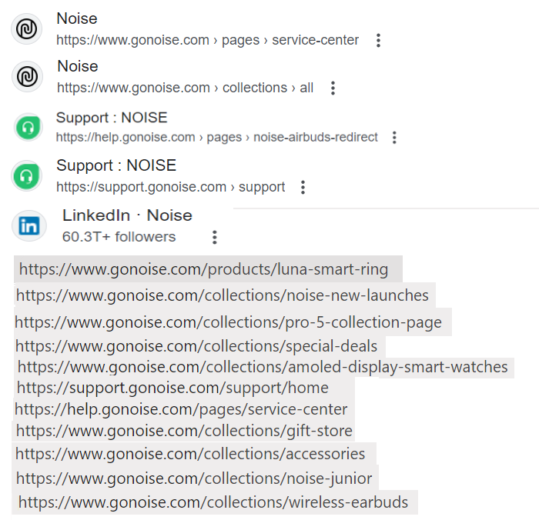
Keywords Research

Slide 31
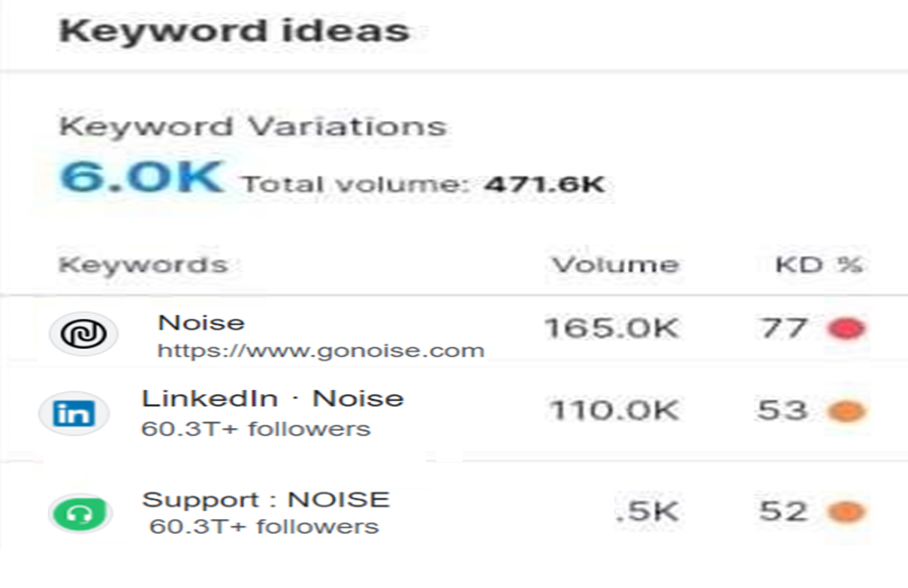
Keywords Ideas

Slide 32
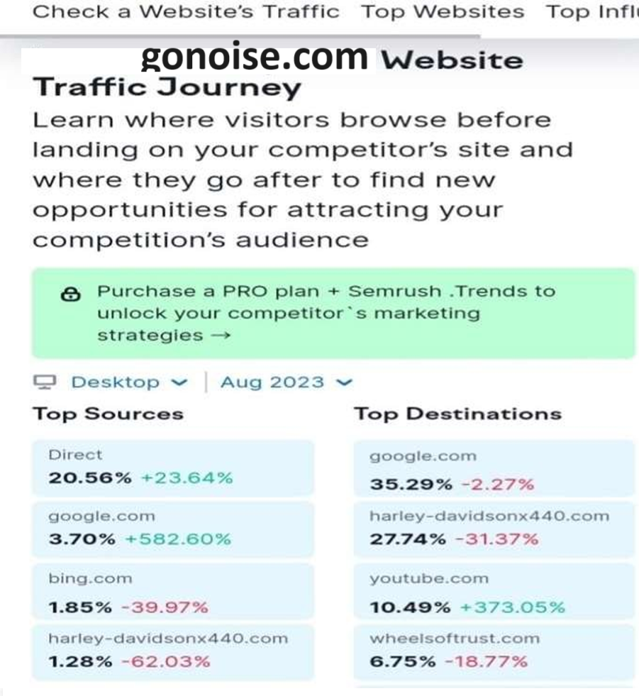
Website Traffic or On Page Optimization

Slide 33
Content Ideas & Strategies
Product Unboxing and Reviews:
Create engaging unboxing videos that showcase the packaging and initial impressions of GoNoise products.
Follow up with detailed reviews that delve into the features, performance, and user experience of each product.

Slide 34
Content Ideas & Strategies
Comparison Guides:
Produce comparison articles or videos that put GoNoise products against competitors in the market, highlighting their unique selling points and advantages.
Collect and share stories from satisfied customers who have had positive experiences with GoNoise products. These can be in the form of written testimonials, video testimonials, or social media posts.

Slide 35
Content Ideas & Strategies
Tutorial Series:
Develop a series of tutorials demonstrating how to use different GoNoise devices for various purposes.
For example, tutorials on setting up and customizing smartwatches, optimizing audio settings on wireless earbuds, or capturing stunning footage with action cameras.
Offer a behind-the-scenes look into the GoNoise headquarters, manufacturing facilities, or product development process. This can help humanize the brand and build trust with consumers.

Slide 36
Content Ideas & Strategies
Interactive Content:
Engage your audience with interactive content such as polls, quizes, or interactive product demos.
This not only entertains your audience but also provides valuable insights into their preferences and interests.
User-Generated Content Campaigns:
Encourage users to share their own experiences with GoNoise products through user-generated content campaigns. Offer incentives such as discounts or giveaways for the best submissions.

Slide 37
Content Ideas & Strategies
Community Building Initiatives:
Foster a sense of community among GoNoise customers by creating online forums, social media groups, or dedicated hashtags where users can connect, share tips, and discuss their favorite products. Corporate Social Responsibility (CSR).
Initiatives:
Highlight GoNoise's commitment to sustainability and CSR initiatives through content that showcases eco-friendly practices, charitable partnerships, or initiatives aimed at reducing the company's environmental footprint.

Slide 38
Content Ideas & Strategies
Community Building Initiatives:
Noise CSR initiative is all about “Caring for Humanity” and we believing in living up to that at every step.
We regularly undertake meaningful initiatives which helps in enriching the lives of marginalized community in meeting their current needs and also prepare the future generation to meet their needs in future by running sustainable programs.
We have touched almost 2,00,000 + people in various walks of life across India. Some of the programs include.
GoNoise can effectively engage its audience, showcase its products, and strengthen its brand presence in the consumer electronics market

Slide 39
Content Ideas & Strategies
Content Marketing:
Create engaging and informative blog posts, videos, and infographics that highlight the features, benefits, and use cases of GoNoise products.
Optimize content for SEO to improve visibility and attract organic traffic from search engines.
Influencer Partnerships: Collaborate with influencers, tech reviewers, lifestyle bloggers, and fitness enthusiasts to promote GoNoise products to their audiences.

Slide 40
Marketing Strategies
Targeted Social Media Campaigns:
Utilize platforms like Instagram, Facebook, and Twitter to showcase GoNoise products through visually appealing content such as photos, videos, and stories.
Leverage Targeted Advertising to reach specific demographics interested in tech gadgets, fitness, outdoor activities, or music.
Influencer Partnerships: Collaborate with influencers, tech reviewers, lifestyle bloggers, and fitness enthusiasts to promote GoNoise products to their audiences.

Slide 41
Marketing Strategies
IIDE Logo :
Sponsor Local community events, sports tournaments, or music festivals to showcase GoNoise products and engage with potential customers. User-Generated Content (UGC)
Campaigns: Encourage customers to share their experiences with GoNoise products on social media using branded hashtags or tagging the company.
Feature user-generated content on GoNoise's official channels to build trust, authenticity, and social proof.

Slide 42
Marketing Strategy
Interactive Experiences:
Host virtual events, webinars, or live Q&A sessions where customers can interact with GoNoise experts, learn about new products, and get their questions answered in real-time.
Develop interactive demos or virtual try-on experiences that allow customers to explore GoNoise products virtually before making a purchase.
Customer Engagement and Support Provide exceptional customer service through multiple channels such as live chat, email, and social media to address inquiries, resolve issues, and build positive relationships with customers.

Slide 43
Marketing Strategy
Interactive Experiences:
Implement loyalty programs or VIP memberships that reward repeat purchases and encourage customer retention.
Data Analytics and Optimization use data analytics tools to track
key metrics such as website traffic, conversion rates, and customer
engagement to optimize marketing campaigns and improve ROI.
Continuously test and iterate marketing strategies based on performance data to stay agile and responsive to changing market dynamics.
By implementing these marketing strategies, GoNoise can effectively raise brand awareness, drive sales, and foster customer loyalty in
the competitive consumer electronics market

Slide 44
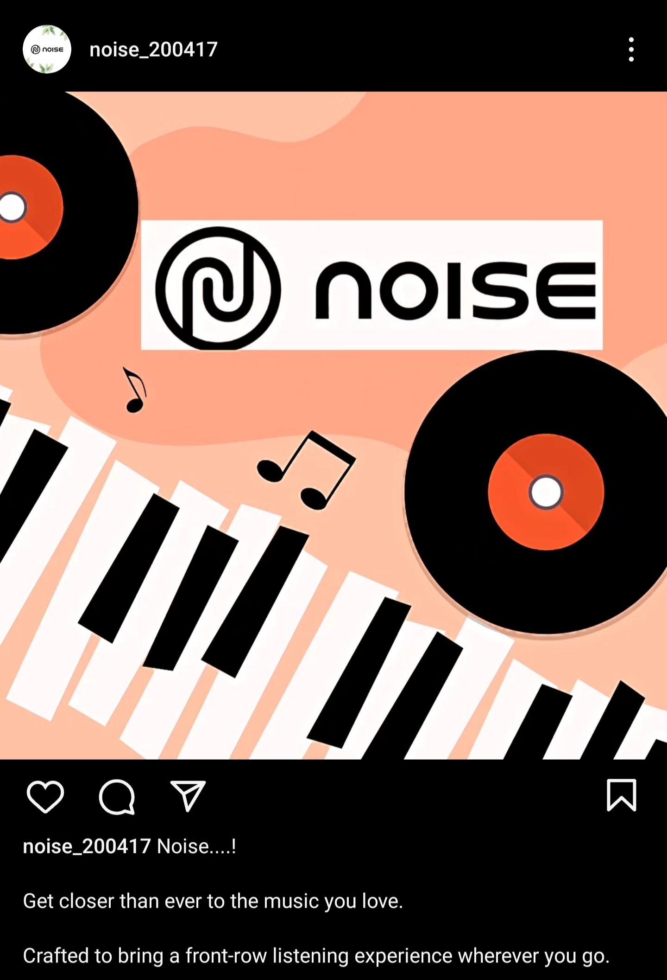
POST CREATION
POST CREATION
https://www.instagram.com/p/C6HLE1pvqXh/?igsh=bWE5eXZyemc2bXVh

Slide 45

Video Editing
Video Editing
https://www.instagram.com/reel/C6IqhxsLd_C/?igsh=Z2hsNzhxdTlvZnM2

Slide 46
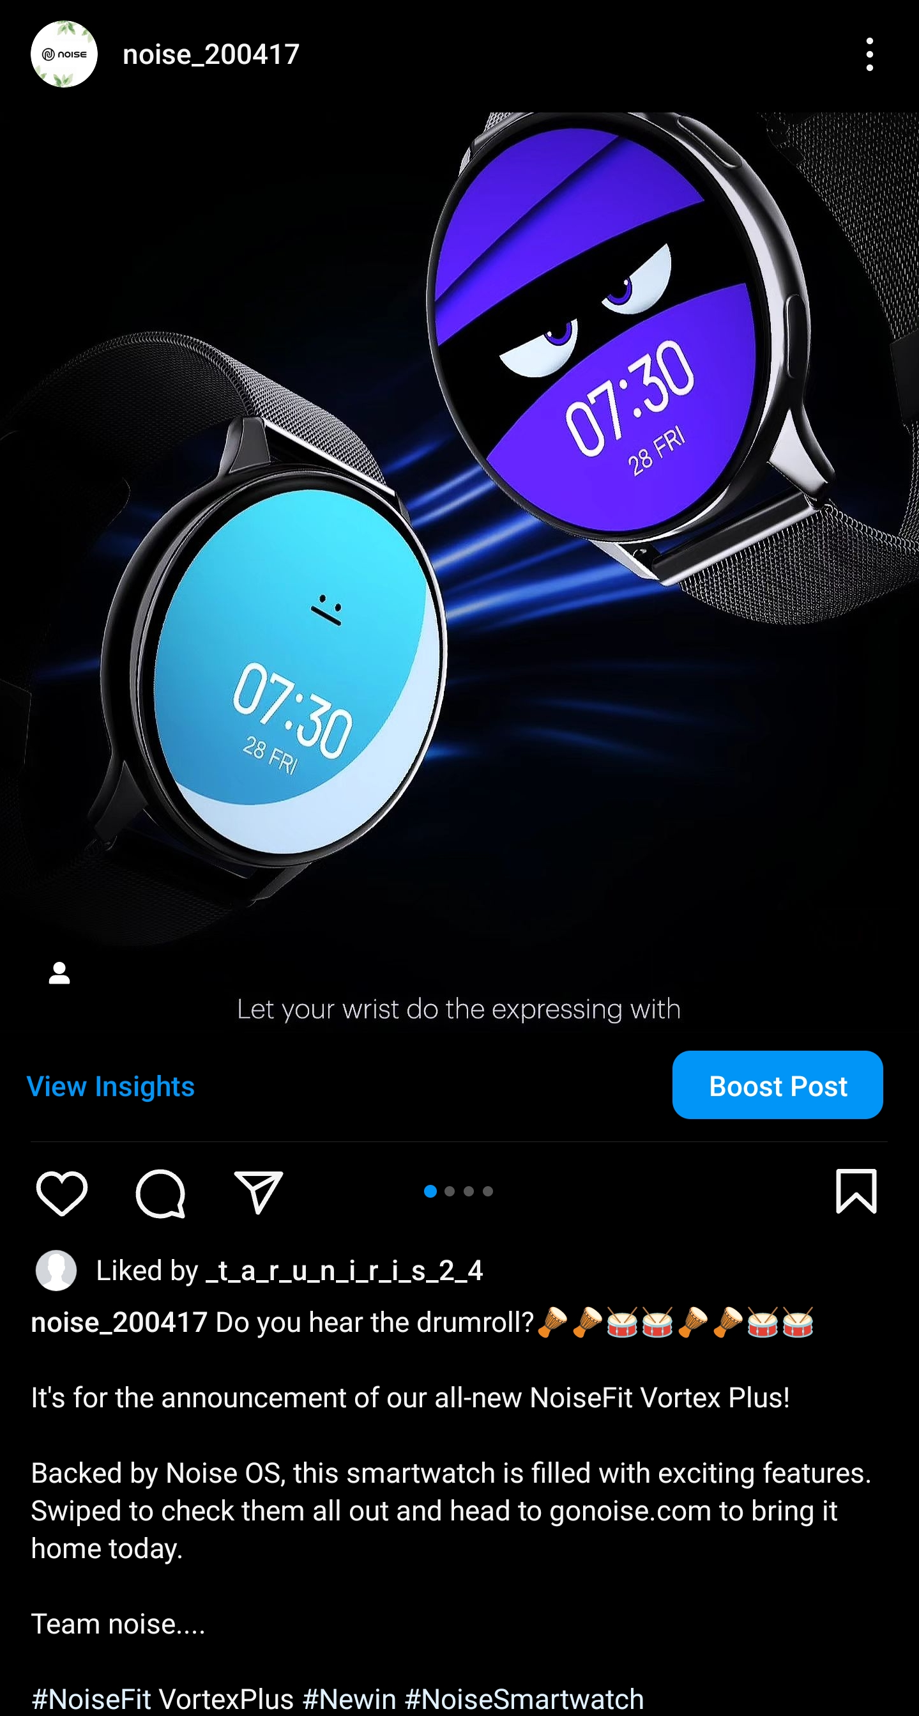
Social media add campaign
Social media add campaign
https://www.instagram.com/p/C6Ixb22LgTc/?igsh=OTVub3drNmtnMjhr

Slide 47
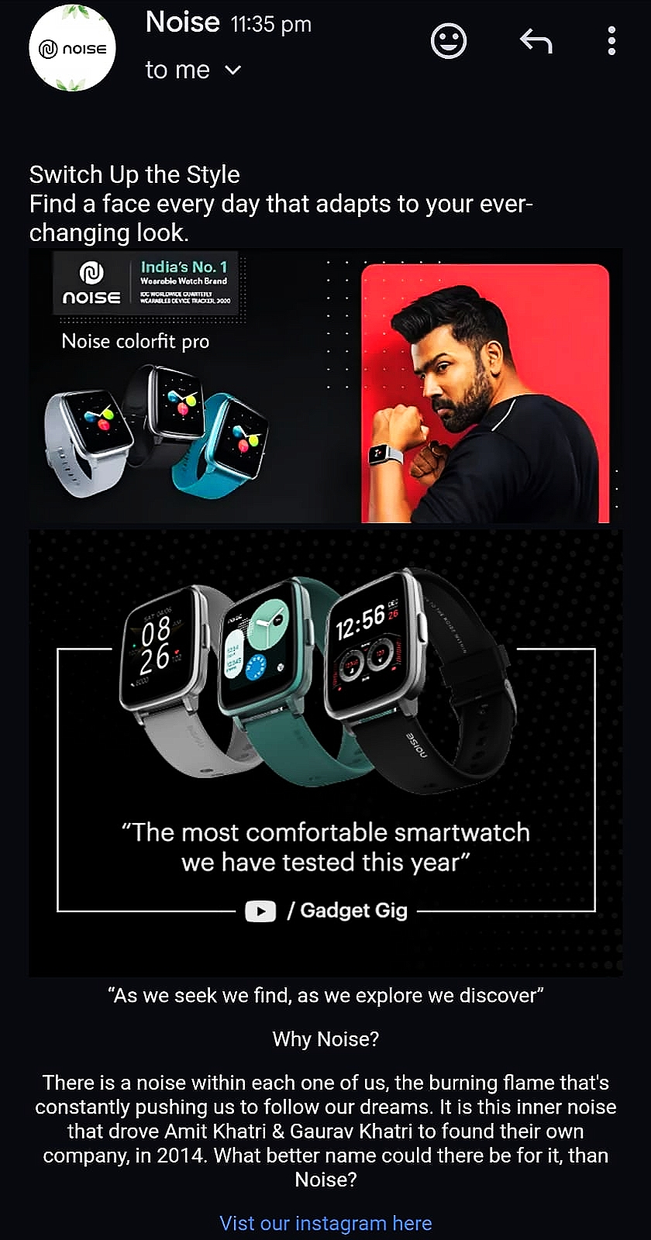
Email add-campaign
Email add-campaign

Slide 48
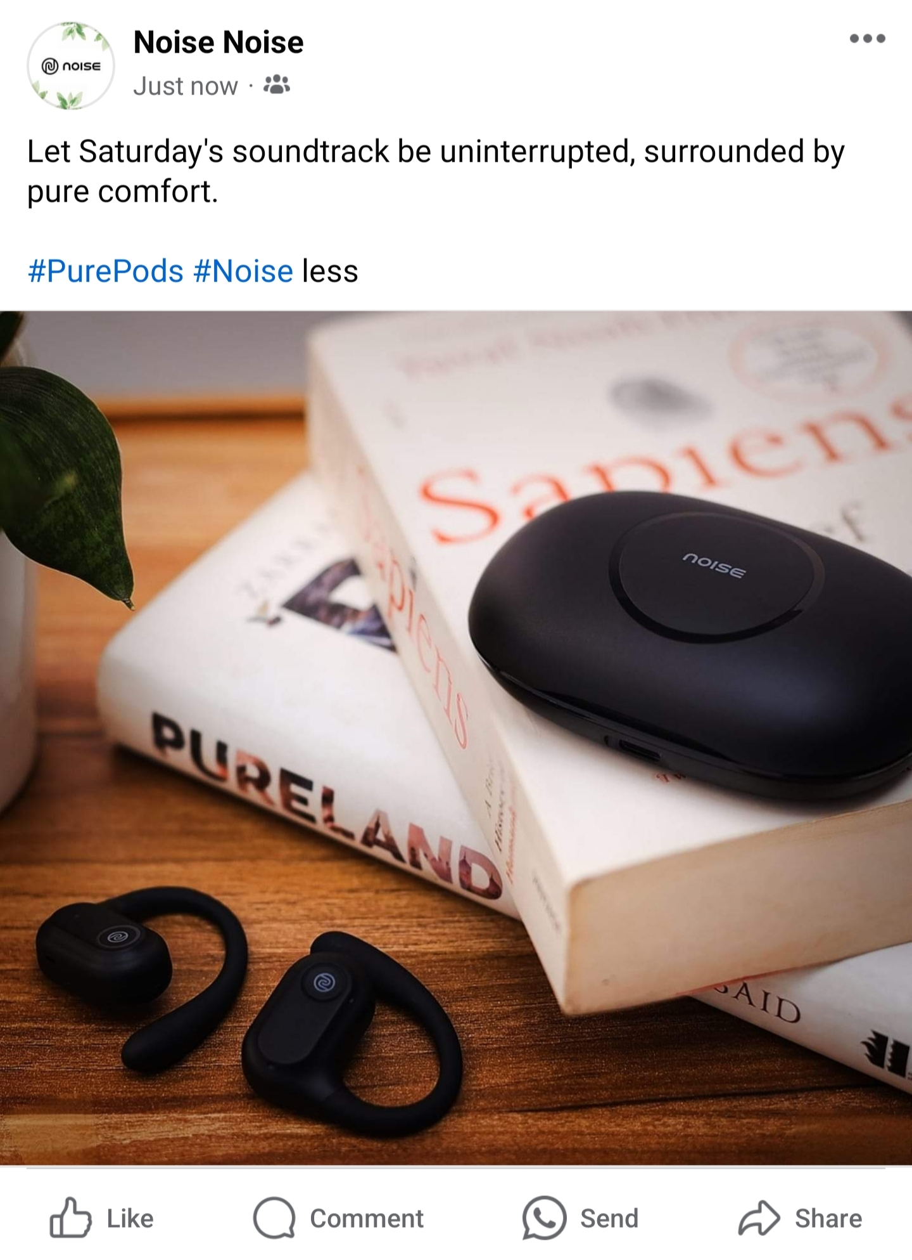
Social media add-campaign
Social media add-campaign
https://www.facebook.com/share/p/cPPA4WnK3LEqFEq7/?mibextid=qi2Omg

Slide 49
Social Media Ad Campaigns
Social media networks have become powerful platforms for advertising, Here are some key insights from Research:
Effectiveness Assessment Factors:
Researchers identify various factors that influence the effectiveness of advertising campaigns on social media networks.
The 'Noise of India' campaign by the brand celebrates various cultural moments across the nation. It aims to honor the diverse tapestry of cultures, traditions, and emotions in India.

Slide 50
Social Media Ad Campaigns
Out of 39 primary assessment factors, eight primary factors stand out:
1. Sales
2. Content reach
3. Traffic to website
4. Impressions
5. Frequency
6. Relevance score
7. Leads
8. Audience growth

Slide 51
Social Media Ad Campaigns
Benefits of Social Media Advertising:
Brand Awareness:
Spread the word about your brand, products, and services.
2. Website Traffic:
Drive more traffic to your website by sharing snippets of articles or using calls-to-action.
3. Sales and Revenue: Experiment with promotional techniques to generate revenue.

Slide 52
Social Media Ad Campaigns
Integration with Other Channels:
Use email to connect with other touch points like social media, blogs, and events:
Research References: - [Evaluation of Advertising Campaigns on Social Media Networks
(https://doi.org/10.3390/su10040973) provides insights into assessing social media ad campaigns.

Slide 53
Social Media Ad Campaigns
Social Media Campaign Web Links:
https://sproutsocial.com/insights/email-marketing/ https://link.springer.com/article/10.1007/s11846-022-00517-9 https://link.springer.com/article/10.1057/rlp.2009.10 https://www.drip.com/blog/email-marketing https://www.journalofadvertisingresearch.com/content/43/3/293 https://www.mdpi.com/2071-1050/10/4/973 https://www.socialmediaexaminer.com/social-media-advertising-research/ https://link.springer.com/article/10.1007/s10660-023-09719-z https://link.springer.com/article/10.1007/s10660-022-09636-7 https://researchbank.swinburne.edu.au/file/1618f811-57be-4b51-8a60-c1eedd6b3e9c/1/PDF%20%28Published%20version%29.pdf https://doi.org/10.3390/su10040973

Slide 54
Email Marketing
Email Marketing:
It involves sending emails to current and potential customers to achieve goals like brand awareness, engagement, lead nurturing, and sales.
Over 4 billion email users worldwide make it an essential channel.
In 2022, the average ROI of email marketing was $36 for every $1 spent by them

Slide 55
Email Marketing
Benefits of Email Marketing:
1. Brand Awareness:
Share valuable content aligned with your brand identity.
2. Generate Website Traffic:
Drive traffic by sharing article snippets or using CTAs.
3. Drive Sales and Revenue:
Promote products, offer discounts, and use upselling techniques, Boost Other Channels Integrate email with social media, landing pages, and blogs.

Slide 56
Email Marketing
Email Marketing Web Links:
https://sproutsocial.com/insights/email-marketing/ https://link.springer.com/article/10.1007/s11846-022-00517-9 https://link.springer.com/article/10.1057/rlp.2009.10 https://www.drip.com/blog/email-marketing https://www.journalofadvertisingresearch.com/content/43/3/293
https://www.mdpi.com/2071-1050/10/4/973 https://www.socialmediaexaminer.com/social-media-advertising-research/ https://link.springer.com/article/10.1007/s10660-023-09719-z https://link.springer.com/article/10.1007/s10660-022-09636-7

Slide 57
Email Marketing
Email Marketing Web Links:
Social Media Advertising: New Research for Marketers.
https://www.socialmediaexaminer.com/social-media-advertising-research/.
Social media influencer marketing: foundations, trends, and ways .

Slide 58
Lessons Learned :
Consistency is Key: Consistency in content creation helps to establish brand recognition and build a loyal audience. Maintaining a consistent brand voice, visual identity, and posting schedule creates a cohesive brand experience for the audience.
Quality Over Quantity: While it's important to consistently create content, focusing on quality should take precedence over quantity. Well-produced and thoughtful content tends to have a more significant impact and can lead to higher engagement and brand loyalty.
Building Relationships and Collaborations: Collaboration with influencers, partners, or customers can provide fresh perspectives and expand the reach of the brand's content. Collaborations help tap into new audiences, bring in diverse ideas, and create engaging content.

